Slide 1
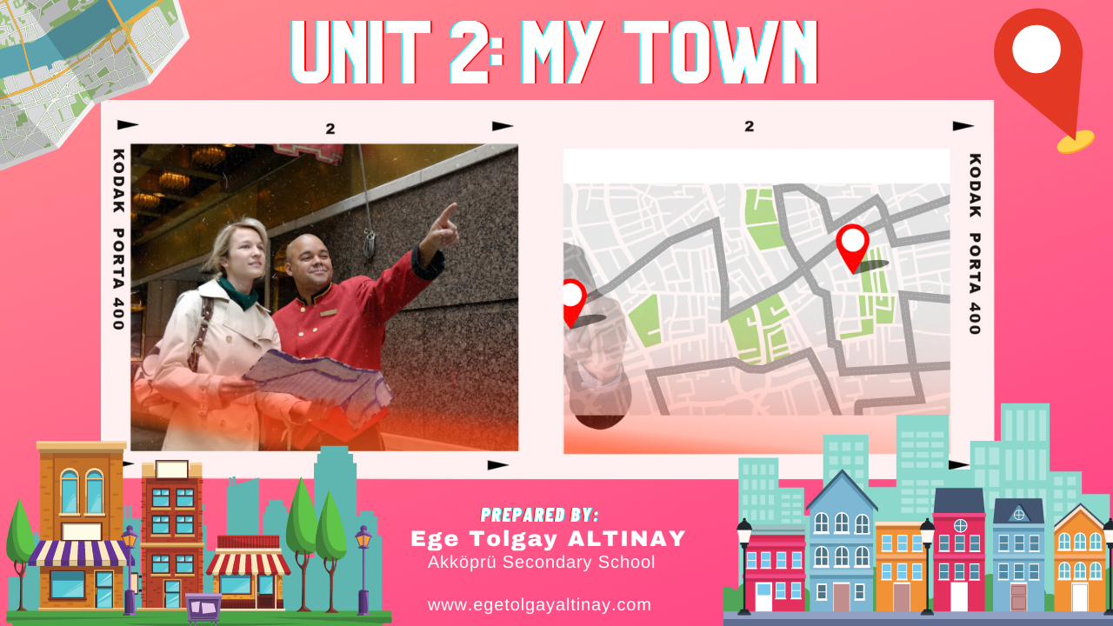
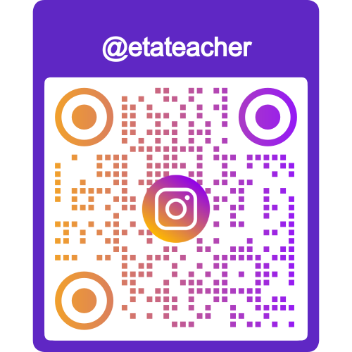

Slide 2
PLACES
(Yerler)

Slide 3
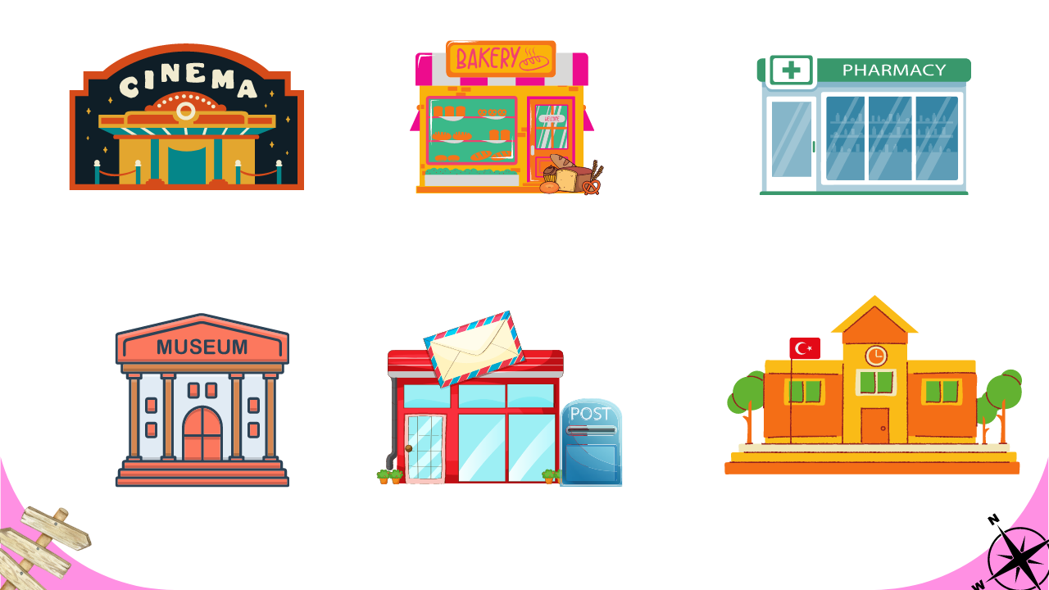
Cinema
Bakery
Pharmacy
Sinema
Fırın
Eczane
Museum
Post Office
School
Müze
Postane
Okul

Slide 4
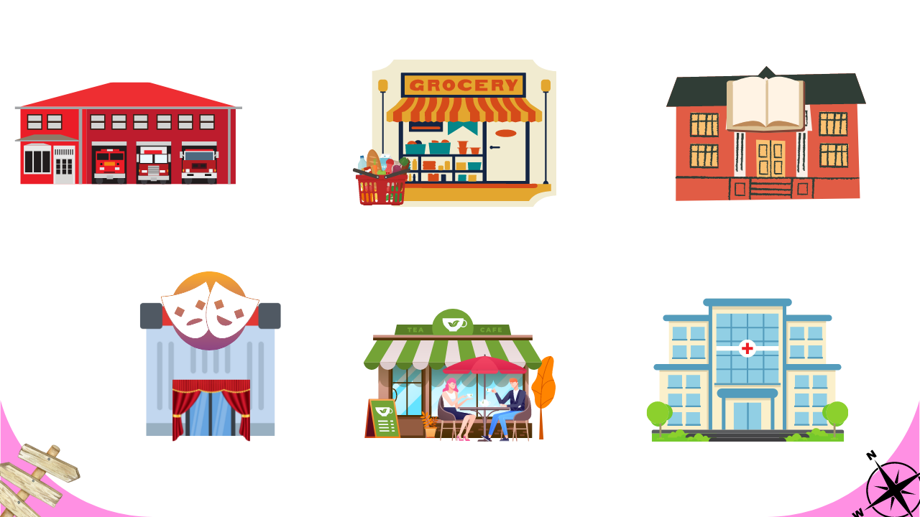
Fire Station
Grocery
Library
İtfaiye
Bakkal
Kütüphane
Theatre
Cafe
Hospital
Tiyatro
Kafe
Hastane

Slide 5
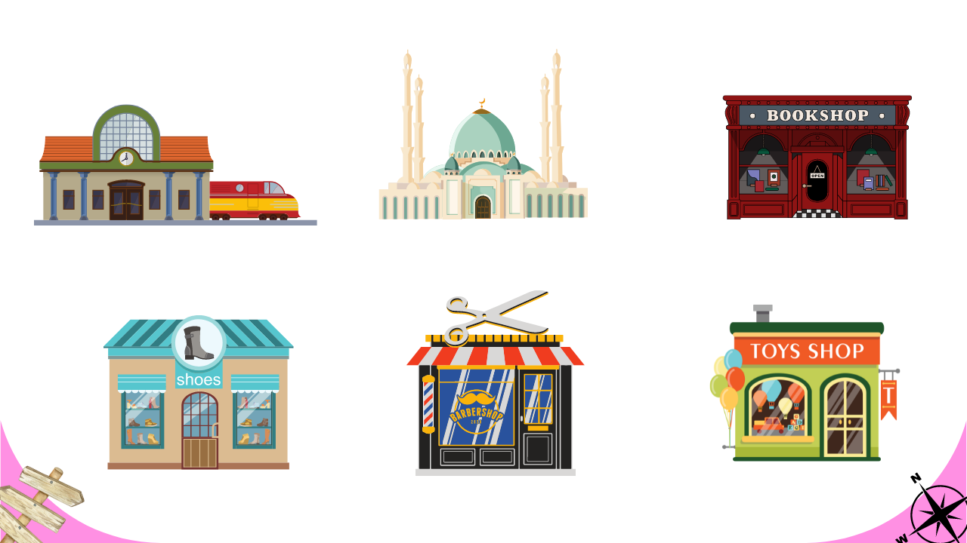
Train Station
Mosque
Bookshop
Tren Garı
Cami
Kitap Dükkanı
Shoeshop
Barbershop
Toyshop
Ayakkabı Dükkanı
Berber Dükkanı
Oyuncak Dükkanı

Slide 6
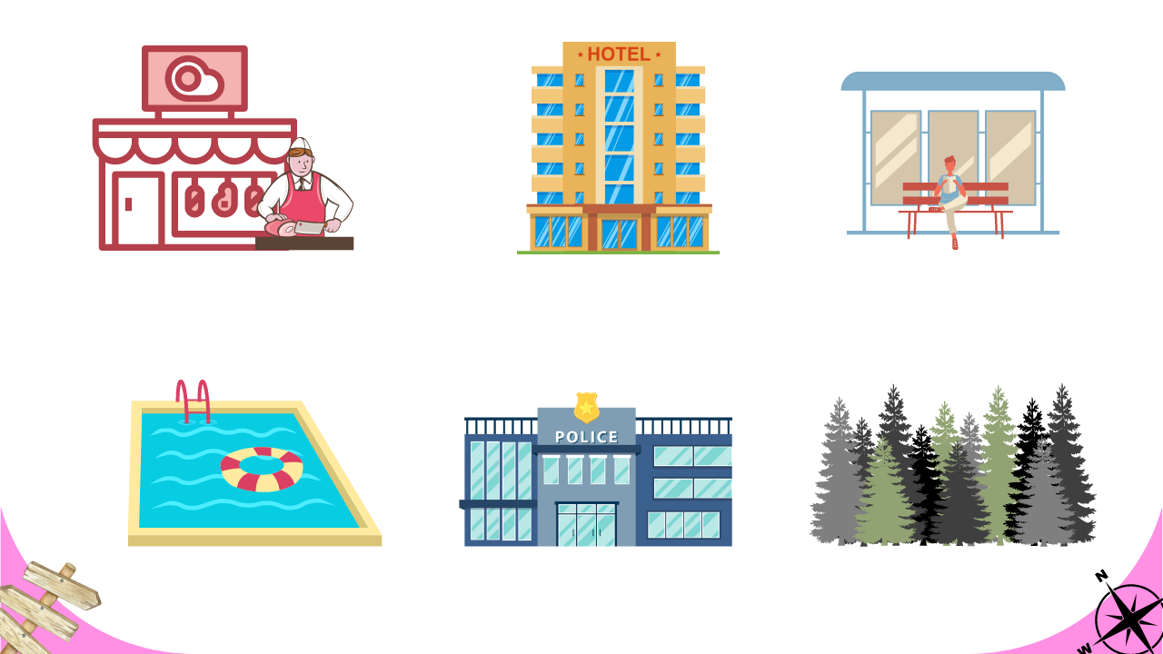
Butcher’s
Bus Stop
Hotel
Kasap
Otobüs Durağı
Otel
Pool
Police Station
Trees
Havuz
Polis Merkezi
Ağaçlar

Slide 7
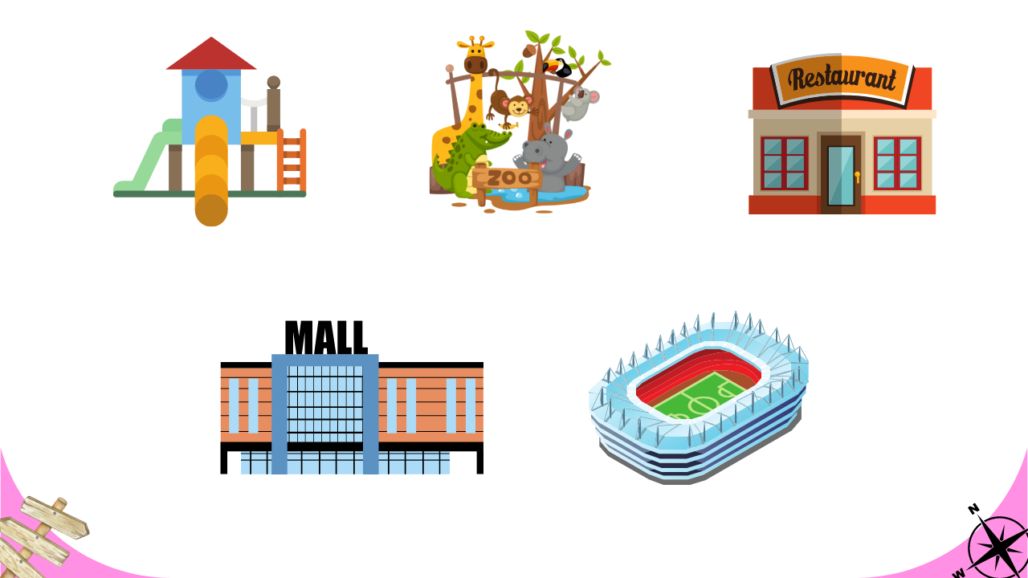
Zoo
Restaurant
Playground
Hayvanat Bahçesi
Restoran
Oyun Alanı
Mall
Stadium
Alışveriş Merkezi
Stadyum

Slide 8
Important Verbs
(Önemli Fiiller)
Swim:
Read a book:
Yüzmek
Kitap okumak
Buy some bread:
Ekmek almak
Watch a movie:
Film izlemek
Buy a toy:
Bir oyuncak almak
Wait for the bus:
Otobüs beklemek
İlaç almak
Listen to my teacher:
Öğretmenimi dinlemek
Get medicine:

Slide 9

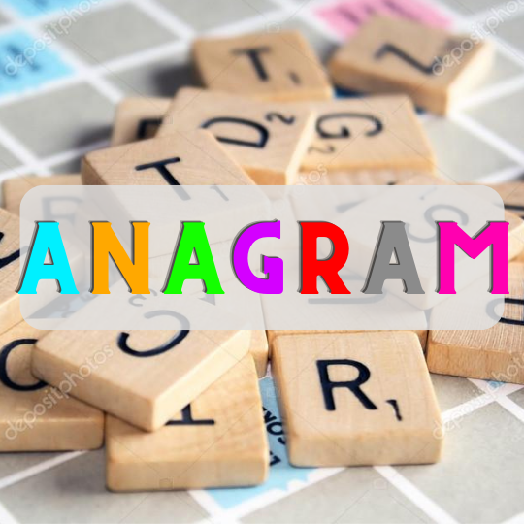
Konu ile ilgili oyuna aşağıdaki linkten ulaşabilirsiniz:
https://www.egetolgayaltinay.com/lessons/56

Slide 10
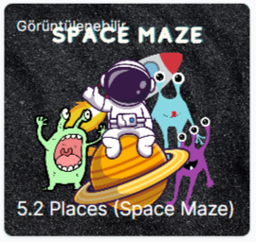
Konu ile ilgili oyuna aşağıdaki linkten ulaşabilirsiniz:
https://www.egetolgayaltinay.com/lessons/336

Slide 11
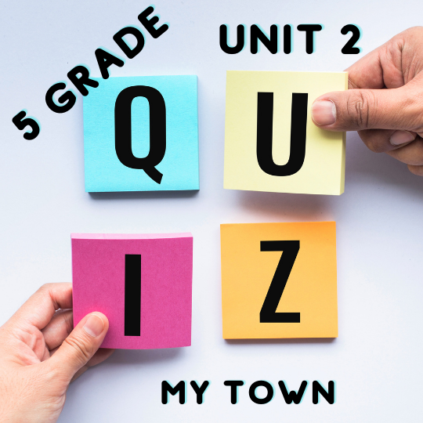
Konu ile ilgili oyuna aşağıdaki linkten ulaşabilirsiniz:
https://www.egetolgayaltinay.com/lessons/55

Slide 12
Prepositions of Place
(Yer Edatları)

Slide 13
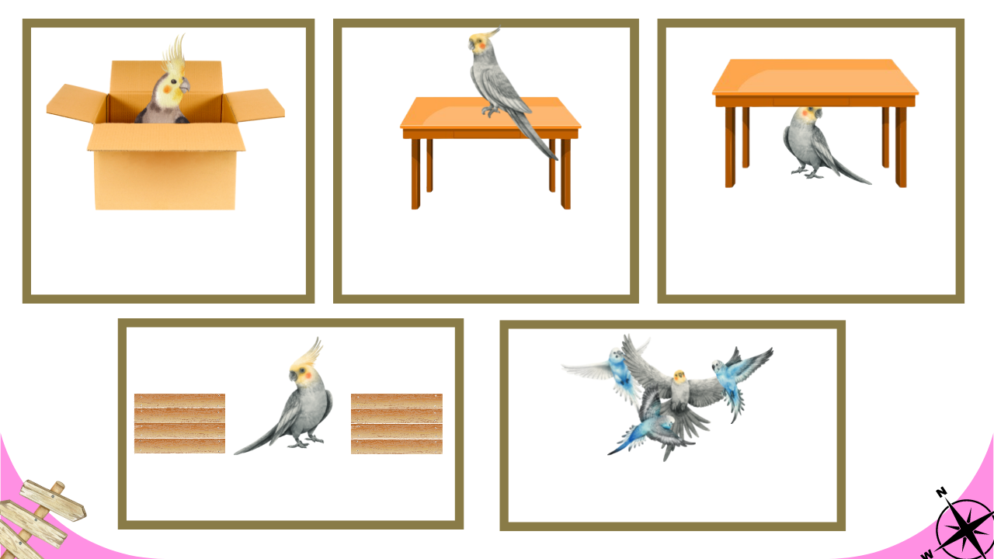
IN:
ON:
İçinde
Üstünde
UNDER:
Altında
BETWEEN:
Arasında
AROUND:
Etrafında

Slide 14
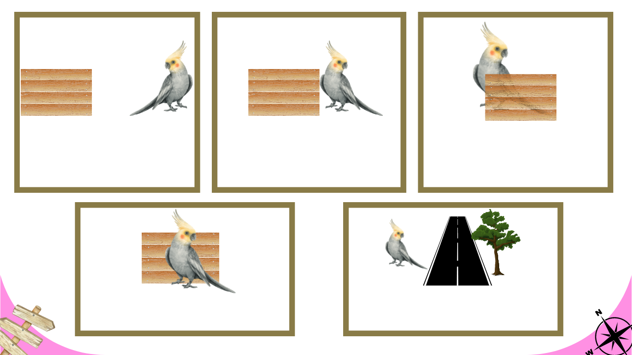
NEAR:
Yanında
NEXT TO:
Bitişiğinde
BEHIND:
Arkasında
IN FRONT OF:
Önünde
OPPOSITE:
Karşısında

Slide 15
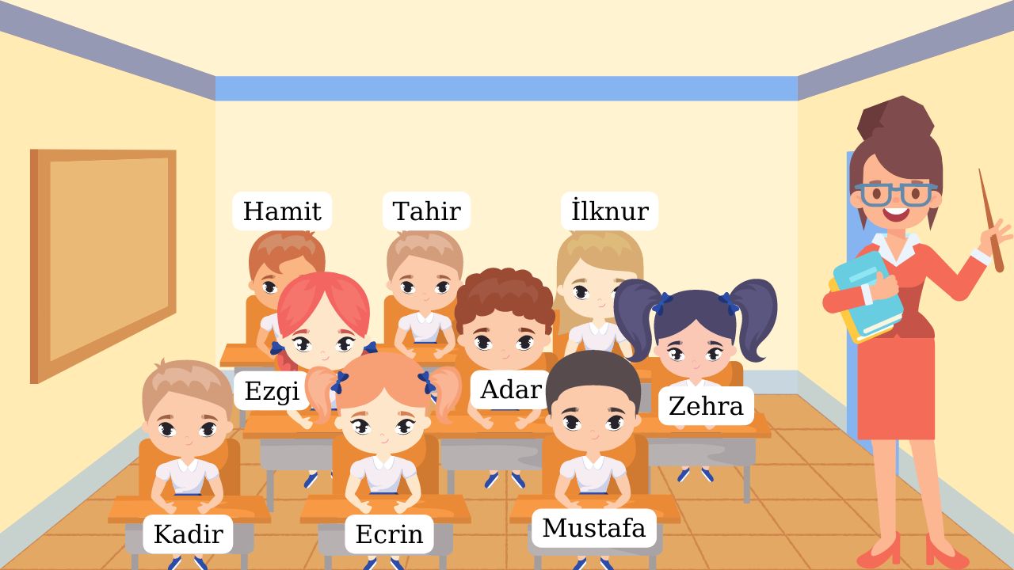
Fill in the blanks according to the seating plan in the picture.
1) Adar is ___________ Ezgi and Zehra.
1) Adar is between Ezgi and Zehra.
2) İlknur is _________ Zehra.
2) İlknur is behind Zehra.
3) Ecrin is _________ Mustafa.
3) Ecrin is near Mustafa.
4) Kadir is _________ Ezgi.
4) Kadir is in front of Ezgi.
5) Ecrin is between ______ and _______.
5) Ecrin is between Kadir and Mustafa.
6) Tahir is behind ________.
6) Tahir is behind Adar.

Slide 16
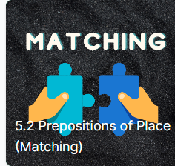
Konu ile ilgili oyuna aşağıdaki linkten ulaşabilirsiniz:
https://www.egetolgayaltinay.com/lessons/69

Slide 17
Giving
Directions
(Yol Tarif Etmek)

Slide 18
How can I go to ______?
______’ya
nasıl
gidebilirim?
How can I get to ______?

Slide 19
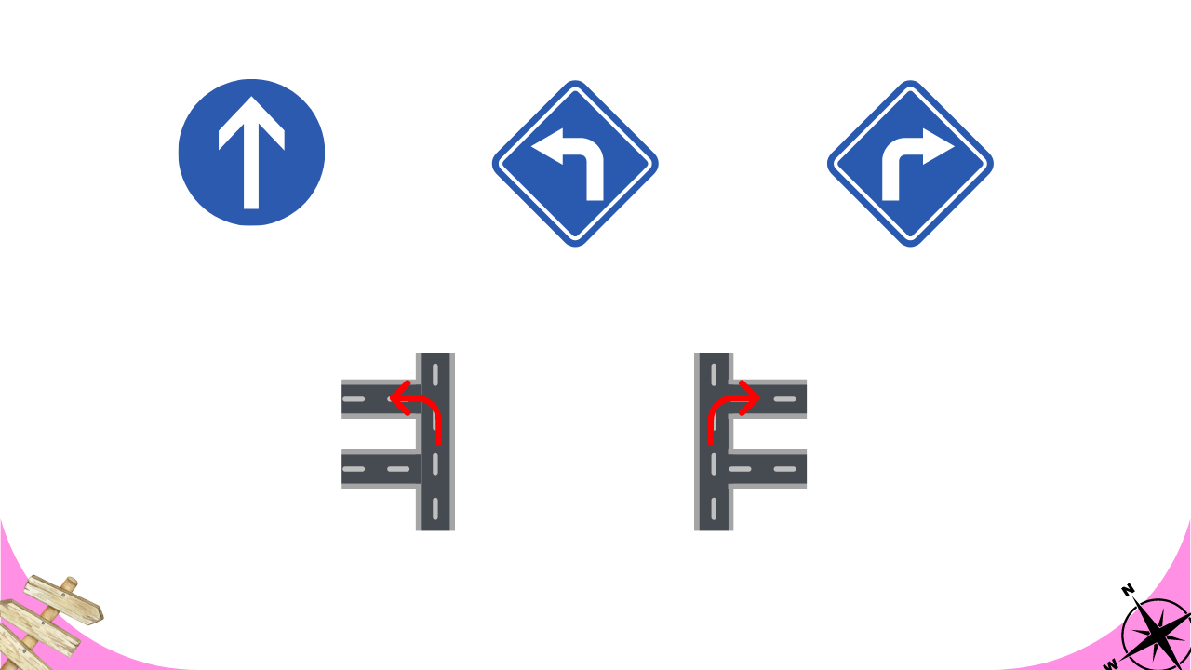
Go straight ahead
Turn left
Turn right
Düz git
Sola dön
Sağa dön
Take the second left
Take the second right
İkinci sola dön
İkinci sağa dön

Slide 20
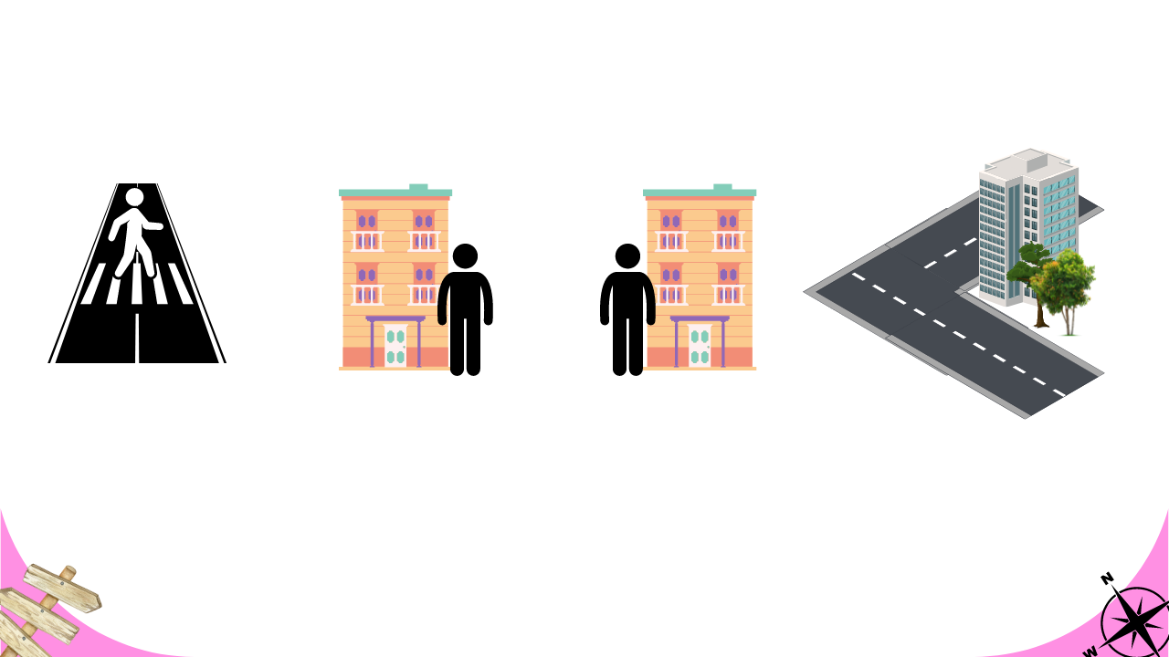
Cross the road
It’s on your left
It’s on your right
It’s on the corner
Karşıdan karşıya geç
Solunda
Sağında
Köşede

Slide 21
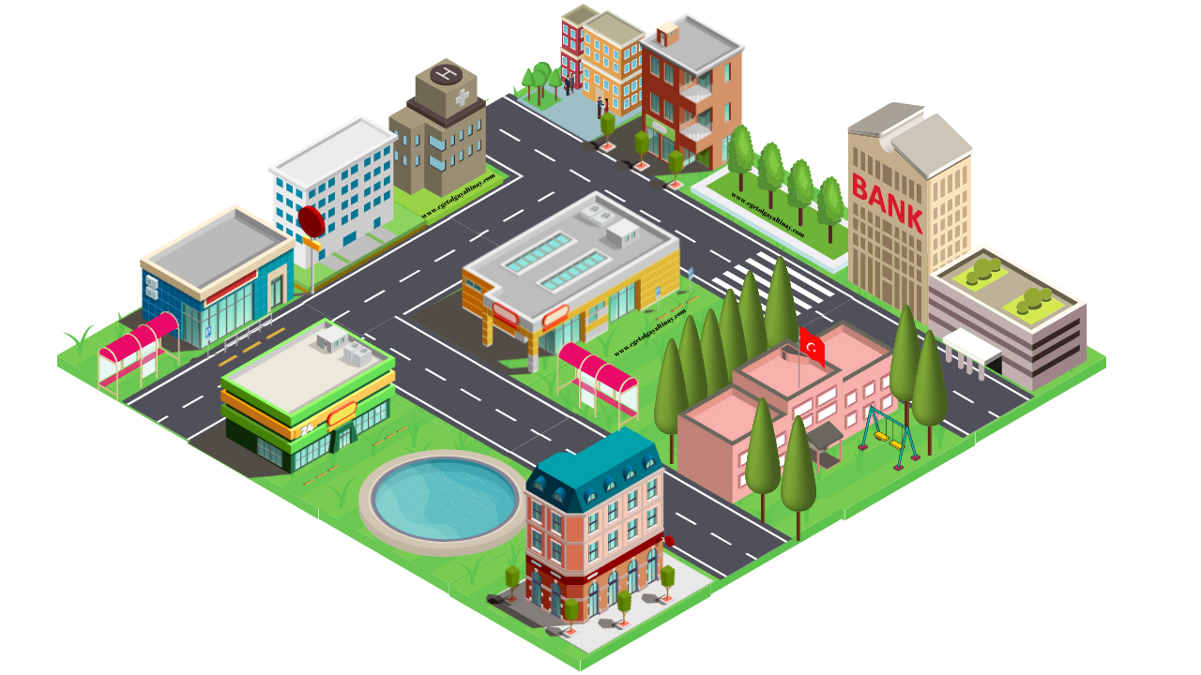

Give the directions according to the map in the picture.
Post Office
Excuse me! How can I get to the Hospital?
Museum
Hospital
Bank
Library
Bakery
Grocery
Mall
_______________ ahead.
Turn ____________.
It’s on your __________ .
It is near the ___________ .
It is __________ the post office
Go straight
Bus Stop
Shoe shop
Bus Stop
right
School
left
Pool
Cafe
Library
You’re here.
opposite

Slide 22
Give the directions according to the map in the picture.
Post Office
Museum
Excuse me! How can I go to the Mall?
Hospital
Bank
Library
Bakery
Grocery
Mall
Bus Stop
Shoe shop
Bus Stop
School
_______________ ahead.
Take the ____________________.
It’s on your __________ .
It is ____________ the Bank.
It is opposite the _____________.
Go straight
You’re here.
Pool
Cafe
second right
left
next to
School

Slide 23
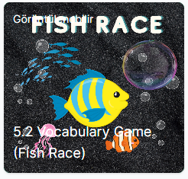
Konu ile ilgili oyuna aşağıdaki linkten ulaşabilirsiniz:
https://www.egetolgayaltinay.com/lessons/335

Slide 24
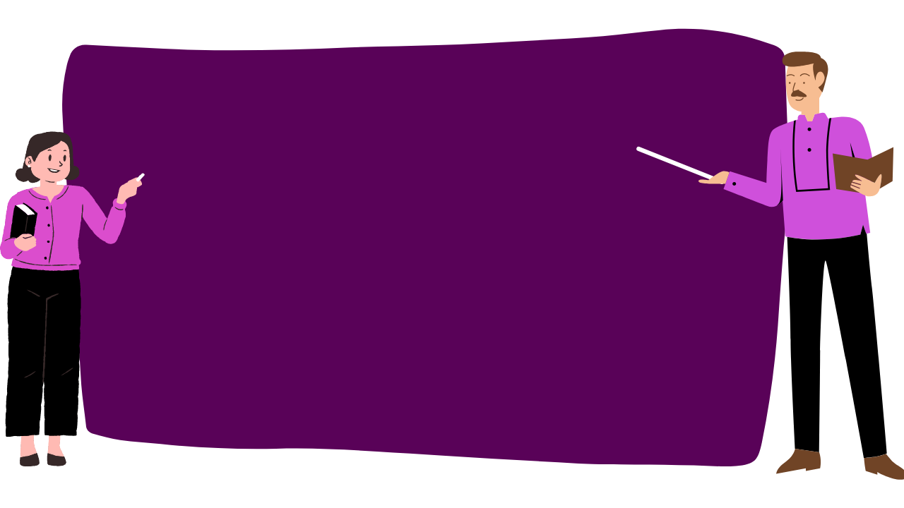
SAMPLE QUESTIONS

Slide 25
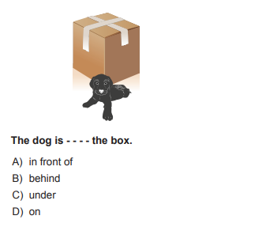

Slide 26
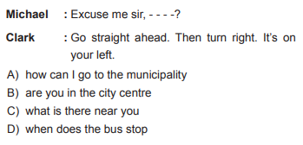

Slide 27
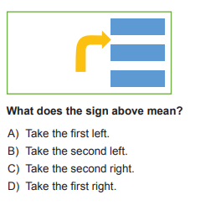

Slide 28
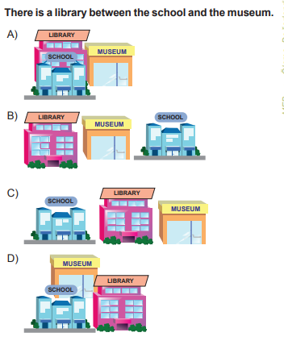

Slide 29
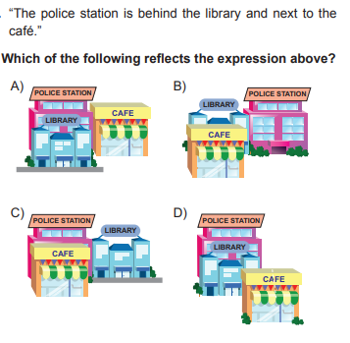

Slide 30
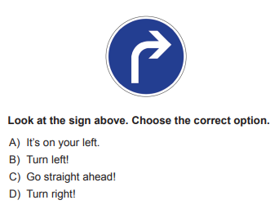

Slide 31

Ünite sonu kelime oyununa aşağıdaki linkten ulaşabilirsiniz:
https://www.egetolgayaltinay.com/lessons/57

Slide 32
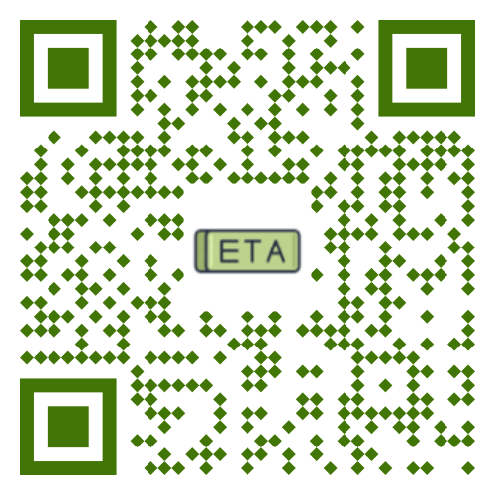

Ege Tolgay Altınay
Akköprü Ortaokulu Tuşba/VAN
Bu, ve benzeri içerikler için:
www.egetolgayaltinay.com adresini ziyaret edebilirsiniz.

Slide 33
Post Office
Museum
Hospital
Bank
Library
Bakery
Grocery
Mall
Bus Stop
Shoe shop
Bus Stop
School
Pool
Cafe

