Slide 2
Değerli meslektaşım, Bu sunumda yer alan etkinlikler, öğrencinin İngilizce konuşma becerilerini ölçmek için
tek başına yeterli değildir.
Öğrencilerin kelime-telaffuz becerilerini ölçmekte kullanılabilir ancak, cümle kurma becerilerini de ölçmek için öğrencinin yanıtına göre «follow-up question» sorulması gerekmektedir.
Şimdiden tüm meslektaşlarıma keyifli bir sınav dönemi diliyorum.
Ege Tolgay ALTINAY

Slide 4
5.2.2 - 5th Grade Speaking Exam - (Spin the Wheel)
https://www.egetolgayaltinay.com/lessons/434

Slide 5
5.6 Movie Types - Speaking Exam - (Spin the Wheel)
https://www.egetolgayaltinay.com/lessons/435

Slide 6
5.7 Months - Speaking Exam - (Open the Box)
https://www.egetolgayaltinay.com/lessons/436
5.7 Phrases About Parties - Speaking Exam - (Spin the Wheel)
https://www.egetolgayaltinay.com/lessons/437

Slide 7
5.8 Fitness Activities 1/2 - Speaking Exam - (Open the Box)
https://www.egetolgayaltinay.com/lessons/438
5.8 Fitness Activities 2/2 - Speaking Exam - (Spin the Wheel)
https://www.egetolgayaltinay.com/lessons/439

Slide 8
5.9 Animals - Speaking Exam - (Open the Box)
https://www.egetolgayaltinay.com/lessons/440

Slide 9
5.10 Numbers 100-1000 - Speaking Exam - (Spin Wheel)
https://www.egetolgayaltinay.com/lessons/441

Slide 11
6.2.2 6th Grade - Speaking Exam (Spin the Wheel)
https://www.egetolgayaltinay.com/lessons/442

Slide 12
6.6 Occupations - Speaking Exam - (Spin the Wheel)
https://www.egetolgayaltinay.com/lessons/443

Slide 13
6.7 Holiday Activities - Speaking Exam - (Open the Box)
https://www.egetolgayaltinay.com/lessons/444
6.7 Irregular Verbs - Speaking Exam - (Flashcards)
https://www.egetolgayaltinay.com/lessons/445

Slide 14
6.8 Words About Books - Speaking Exam - Spin the Wheel
https://www.egetolgayaltinay.com/lessons/446

Slide 15
6.9 Bad Things for Environment - Speaking Exam - (Spin the wheel)
https://www.egetolgayaltinay.com/lessons/447
6.9 Good Things for Environment - Speaking Exam - (Spin the Wheel)
https://www.egetolgayaltinay.com/lessons/448
6.9 Environmental Problems - Speaking Exam - Open the Box
https://www.egetolgayaltinay.com/lessons/449

Slide 16
6.10 Words About Elections - Speaking Exam - (Open the Box)
https://www.egetolgayaltinay.com/lessons/450

Slide 18
7.2.2 7th Grade - Speaking Exam - (Spin the Wheel)
https://www.egetolgayaltinay.com/lessons/451

Slide 19
7.5 TV Programmes - Speaking Exam - (Spin the Wheel)
https://www.egetolgayaltinay.com/lessons/452

Slide 20
7.6 Countable/Uncountable - Speaking Exam - (Open the Box)
https://www.egetolgayaltinay.com/lessons/453
7.6 Needs for Celebrations - Speaking Exam - (Spin the Wheel)
https://www.egetolgayaltinay.com/lessons/454
7.6 Verbs about Celebrations - Speaking Exam - (Spin the Wheel)
https://www.egetolgayaltinay.com/lessons/455

Slide 21
7.7 Verbs about Future 1/2 - Speaking Exam - (Spin the Wheel)
https://www.egetolgayaltinay.com/lessons/456
7.7 Verbs about Future 2/2 - Speaking Exam - (Spin the Wheel)
https://www.egetolgayaltinay.com/lessons/457

Slide 22
7.8 Public Buildings - Speaking Exam - Open the box
https://www.egetolgayaltinay.com/lessons/471

Slide 23
7.9 Bad Things for the Environment - Speaking Exam - (Flash Card)
https://www.egetolgayaltinay.com/lessons/458
7.9 Good Things for the Environment - Speaking Exam - (Flash Card)
https://www.egetolgayaltinay.com/lessons/460
7.9 Environmental Problems - Speaking Exam - (Open the Box)
https://www.egetolgayaltinay.com/lessons/459

Slide 25
8.2.2 - 8th Speaking Exam - Spin the Wheel
https://www.egetolgayaltinay.com/lessons/461

Slide 26
8.6 Adventures - Speaking Exam - (Spin the Wheel)
https://www.egetolgayaltinay.com/lessons/462
8.6 Extreme Sports Places - Speaking Exam - (Open the Box)
https://www.egetolgayaltinay.com/lessons/463

Slide 27
8.7 Accomodations Speaking Exam - (Open the Box)
https://www.egetolgayaltinay.com/lessons/464
8.7 Tourist Attractions - Speaking Exam - (Flashcards)
https://www.egetolgayaltinay.com/lessons/465

Slide 28
8.8 Rules - Speaking Exam - (Spin the Wheel)
https://www.egetolgayaltinay.com/lessons/467
8.8 Household Chores - Speaking Exam - (Open the Box)
https://www.egetolgayaltinay.com/lessons/466

Slide 29
8.9 Inventions - Speaking Exam - (Open the box)
https://www.egetolgayaltinay.com/lessons/468
8.9 Professions about Science - Speaking Exam - (Open the box)
https://www.egetolgayaltinay.com/lessons/469

Slide 30
8.10 Possible Problems - Speaking Exam - (Spin the Wheel)
https://www.egetolgayaltinay.com/lessons/470

Slide 31
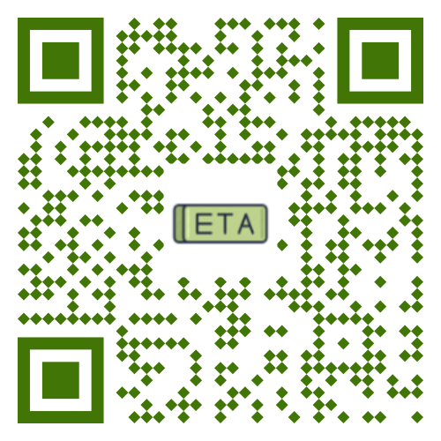
Ege Tolgay Altınay
Akköprü Ortaokulu Tuşba/VAN
Bu, ve benzeri içerikler için: www.egetolgayaltinay.com adresini ziyaret edebilirsiniz.

